Slide 1
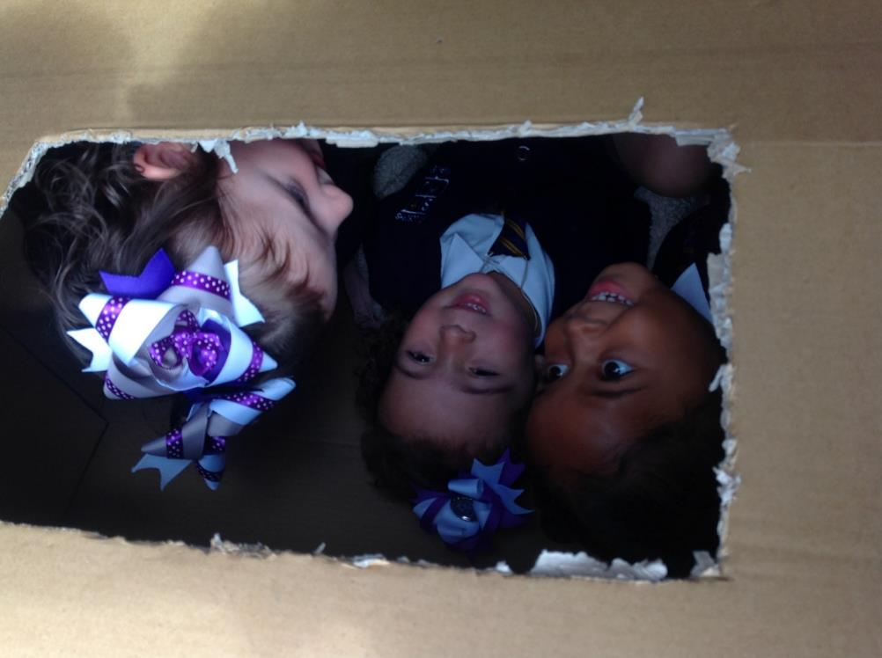

Welcome Back!

Slide 2
Welcome Back!
Dear Children
We are looking forward to welcoming all of you back to school in September. Please read through this presentation with an adult so that you know what to expect when we return.
When you do come back, you may notice a few changes that have been put in place to keep you and everybody in our school community safe. We would like to share some of these with you so that you know what to look out for on your return.
During the first few days we will all be learning and talking about ‘Wellbeing.’ We want to help and support everybody with strategies to stay healthy, happy and well during these unusual times.
In the meantime, we hope you find this information helpful in preparation for September.

Slide 3
Staying Safe
When you return to school, our values are still the same. We want to make sure that our school in still a safe and happy place for everybody.
Respect
Ready
Resilience

Slide 4
Covid Code of Conduct
We have added some extra rules to keep everybody safe. This is called our COVID Code of Conduct. You may already know some of these rules if you have been listening to the news or if you have been out for a walk with your family.
1. Look for new signs around school and listen carefully to instructions.

Slide 5
Covid Code of Conduct
You may have heard of ‘social distancing’ or the 2 metre rule. Around our school there will be lots of markers on the floor to help you keep 2 metres between yourself and everybody in our school.
2. Always follow the 2m social distancing rule and stay with your class group.

Slide 6

Covid Code of Conduct
Please remember to have a tissue in your pocket or up your sleeve at all times. There will be boxes of tissues in every class so that you can replace yours if you need to.
3.Help to stop the spread of germs by always carrying a tissue.

Slide 7

Covid Code of Conduct
Hand hygiene is extremely important. Your classroom will have two bottles of hand sanitizer to help reduce the spread of germs. Your group will also be sent to the toilet during the day to wash your hands.
4. Regularly wash your hands for 20 seconds and use the hand sanitisers provided.

Slide 8
Covid Code of Conduct
We all have a responsibility to look after each other. Please be considerate at all times. Use your tissue to help stop the spread of germs.
5. Never cough or spit at or towards another person.

Slide 9
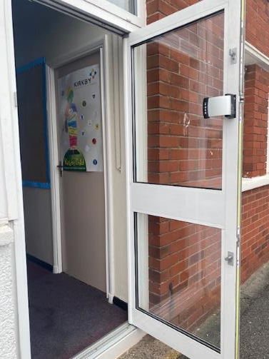
Arriving in the morning
When you arrive in the morning you may come at a different time and go straight into your classroom.
For Year 6 you will need to walk around the back of school and enter via the Hub
Your classroom door will be open for you to arrive between 8.50 – 9:00am

Slide 10
Around the School
You will notice that the school may not seem the same as you remember; this is to keep everybody safe. Some areas of the school will be out of bounds for children. Remember to look for the signs to keep you safe.

Slide 11
In Class
When you arrive in school, staff will direct you safely to sanitise your hands. Your class will stay together all day and not mix with the other year groups.

Slide 12
In Class
When you enter your classroom, you will be given your own desk. You will also be given a plastic wallet with your stationary in it. This can be stored in your labelled bag and kept on your desk. You do not need to bring anything else to school.

Slide 13
Staying Sun Safe & Hydrated
Remember to bring a water bottle with you to drink during the day, please make sure it has your name on.
The weather in September can be hot, if this is the case please remember to put on sun cream in the morning before you leave the house.

Slide 14
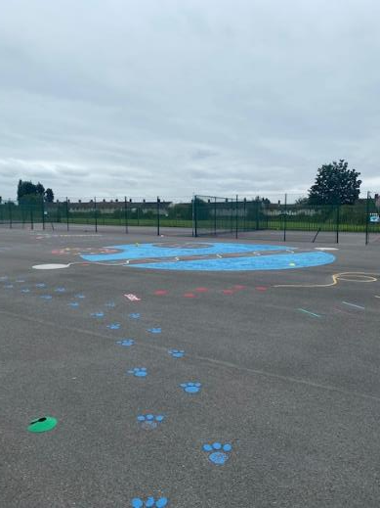
Lunch times and Playtimes
At playtimes you will be able to play with the children in your class. We have split the playground Section A and Section B to keep you safe. It is important that you stay with the children in your class. Sometimes, the staff will organise equipment and games for you to play with. Please listen to instructions about where your group can play.

Slide 15
Lunch
Every morning your teachers will tell you what is on the menu for lunch. You will be able to choose from a selection of hot meal, sandwiches or jacket potato. This will be served with a piece of fruit, a drink and a treat. You will be eating in a special section of the dining hall, your lunch will be brought to your table by a member of staff. The hall will be split into section A and section B. Your teacher will tell you which section of the hall you will eat your lunch in.

Slide 16
A Day in School
Every group has been assigned their own toilet cubicles. Your teachers will show you which toilets you are allowed to use.
Everybody in your group will use the same toilets. Look out for labels on the doors to help you.

Slide 17
Code of Conduct
Every day you will be reminded of the COVID Code of Conduct by your teachers. You will also talk about the rules that will keep you safe while you are in school.
We won’t be able to have any whole school gatherings like assemblies but your teachers will have planned lots of fun activities for you to complete. These will include English, Maths and reading tasks, as well as some topic work in the afternoons.
Every group has been given some outdoor space so that when the weather is nice, you will be able to work outside.

Slide 18

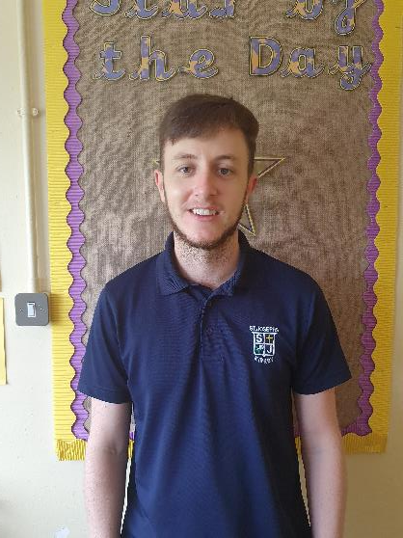
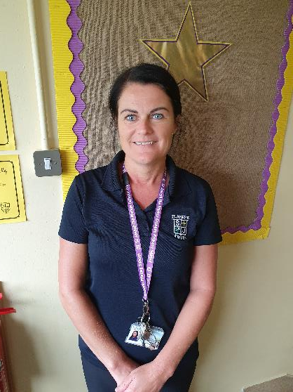
Here are your teachers:
Mr Pearce Mrs Bradshaw

Slide 19
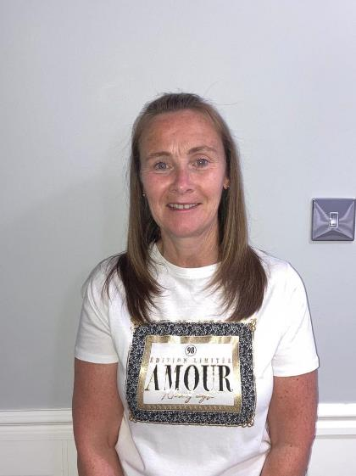
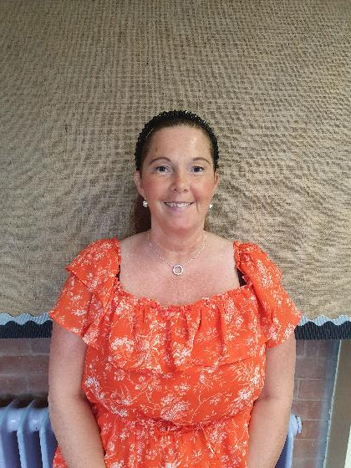
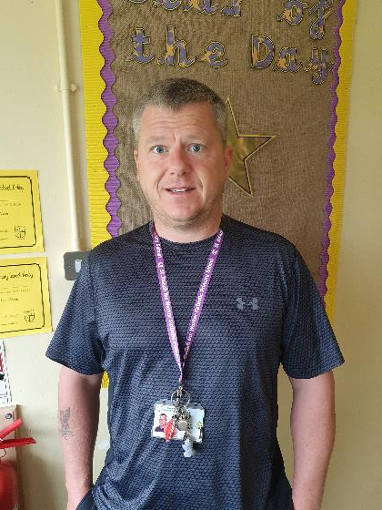
Here are your teaching assistants:
Mrs Linford (1:1) Mr Moorhouse (1:1) Mrs Crozier

Slide 20
See you in September!
We hope that this has been useful in preparing you for September. It is very important for us to keep you and all of the other children and staff in our school community safe. We hope that the changes that we have made will keep everybody safe and healthy.
If you have any questions, you can write them down and bring them to school with you when you come. You will have chance to talk with your teachers and class.
We look forward to seeing you.
Mrs Ryan and all of the St Joseph the Worker Staff

